Slide 1

BANK
MANAGEMENT
SYSTEM (SWIFTBANK)
TEAM MEMBERS
Santhish kumar Nagarajan – 002896009
Sai Krishna Reddy Gaddam – 002856847
Vishruth Telugu Venugopal – 002839861
Sai Abhishek ILa – 002240088
Riya Singh-002272109

Slide 2
PROJECT OVERVIEW
ROADMAP
Database design and conceptual modelling
Our system is designed to streamline operations,enhance customer experience, and ensure the efficient management of transactions and also presenting ATM and online banking activities.
Database creation and implementation
Database model enhancement and visualization

Slide 3
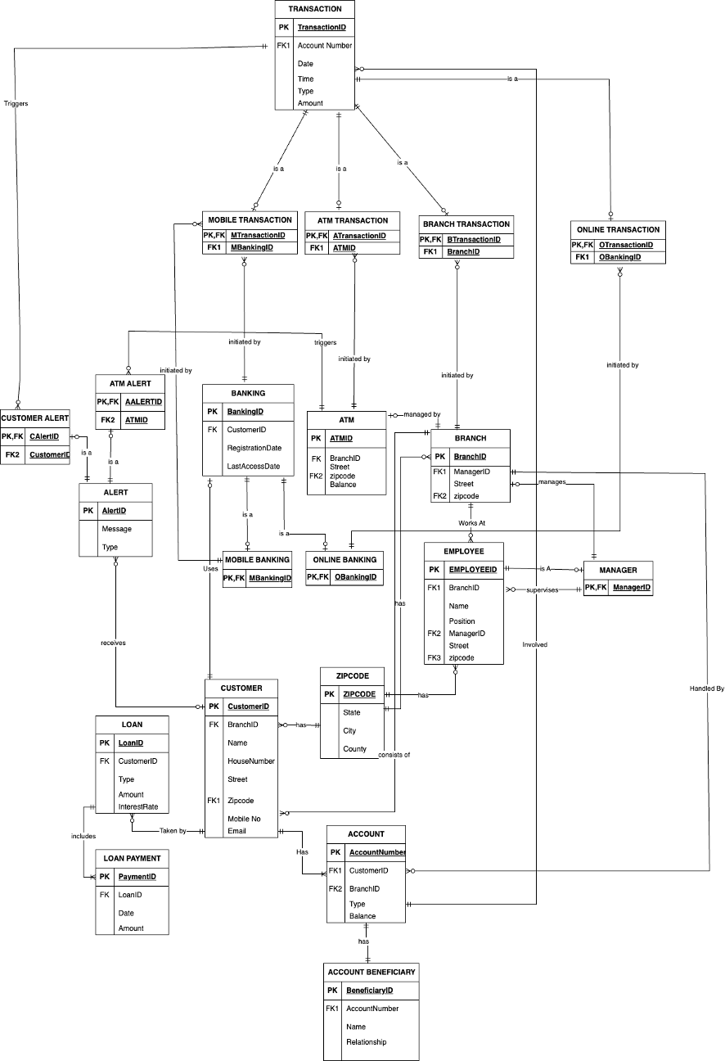
Creating an Entity-Relationship Diagram (ERD)
STEPS INVOLVED
Identifying Entities
Establishing Relationships
Understanding Cardinality and Participation
Normalization
Data Types and Constraints

Slide 4

Database Initialization
Execution of
DDL Statements
DML Statements

Slide 5
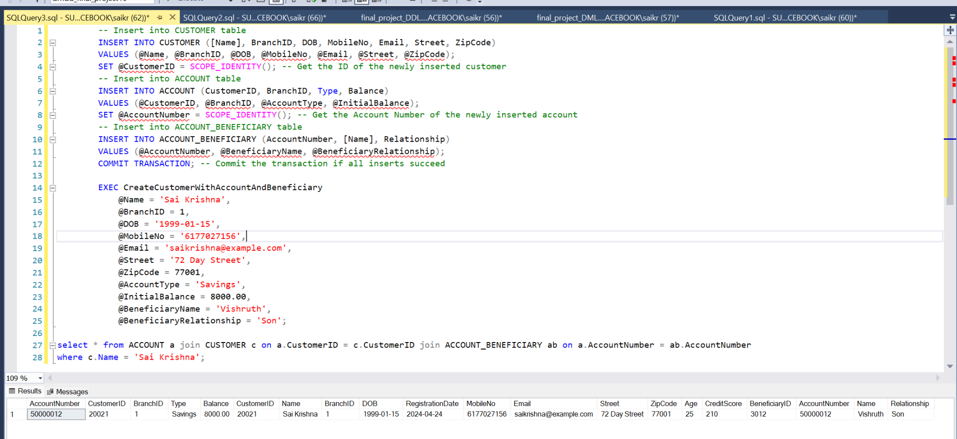
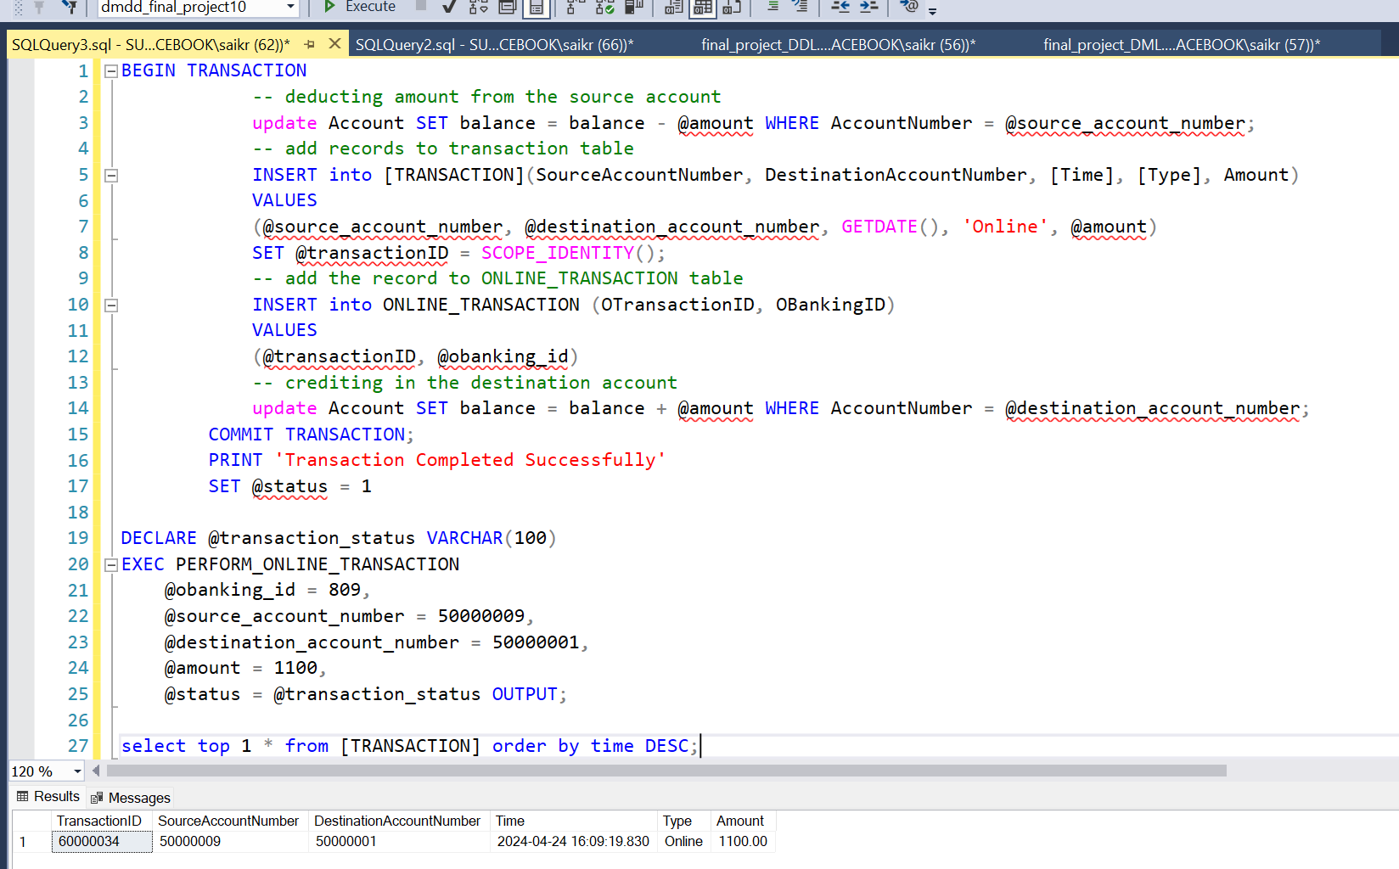
Creation of Stored Procedures
Create Customer With Account And Beneficiary
Perform Online Transaction

Slide 6
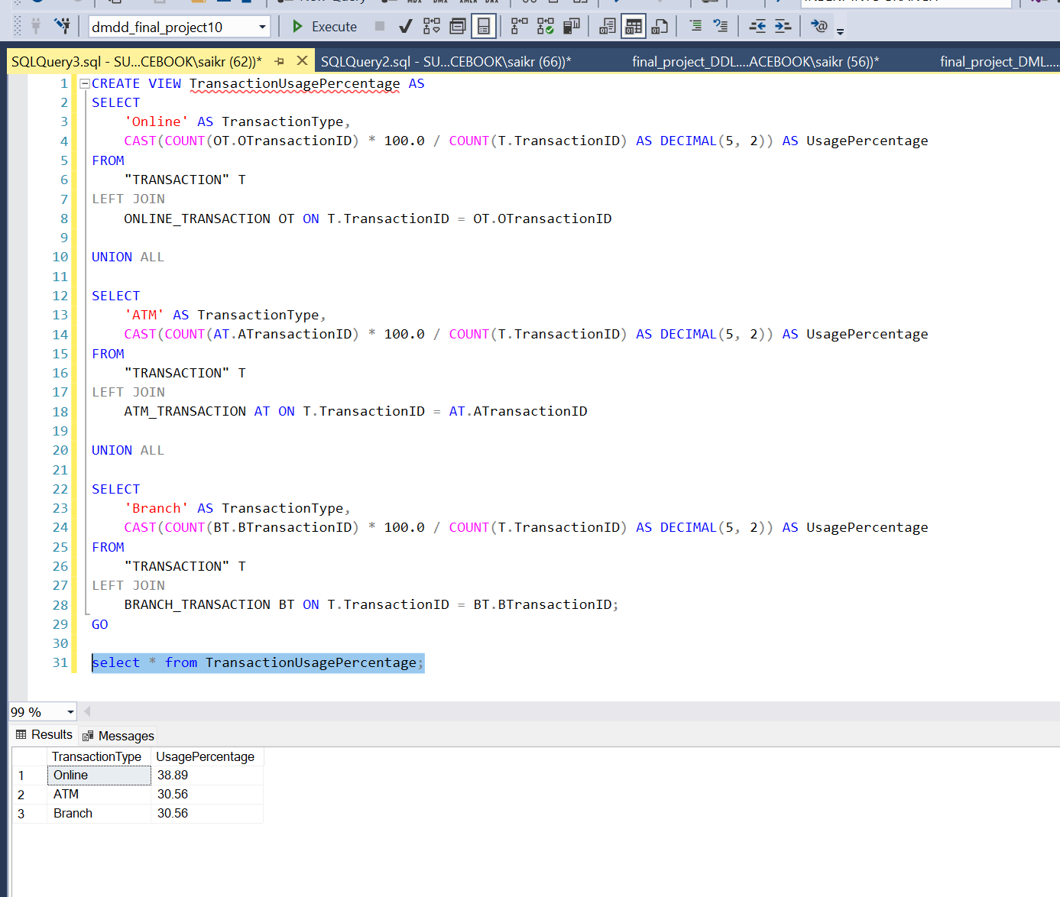
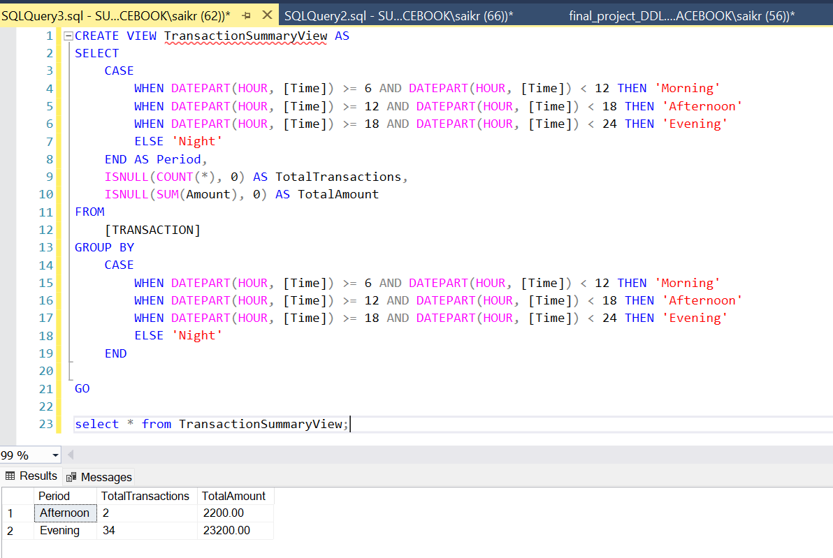
Creation of Views

Slide 7
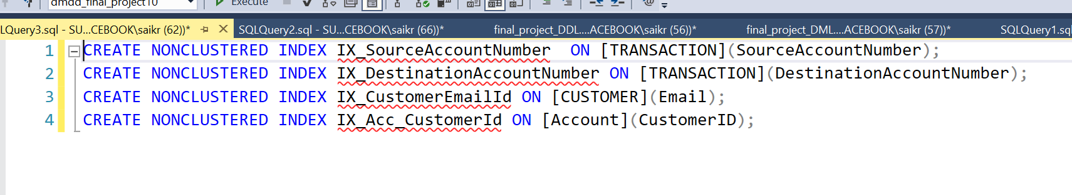
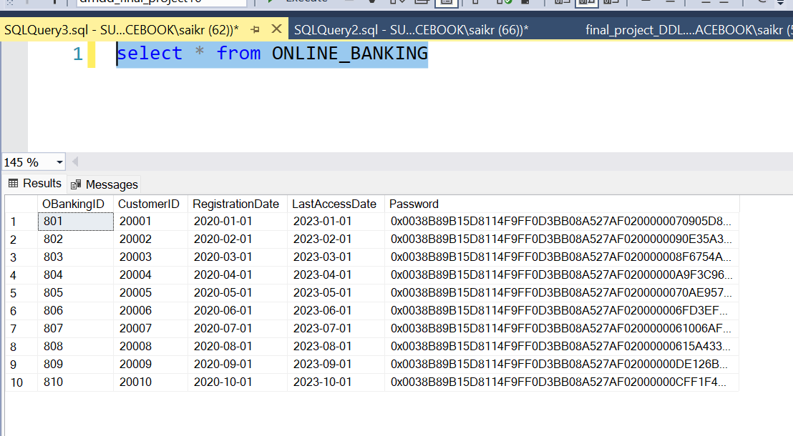
Adding indexing
Encryption

Slide 8
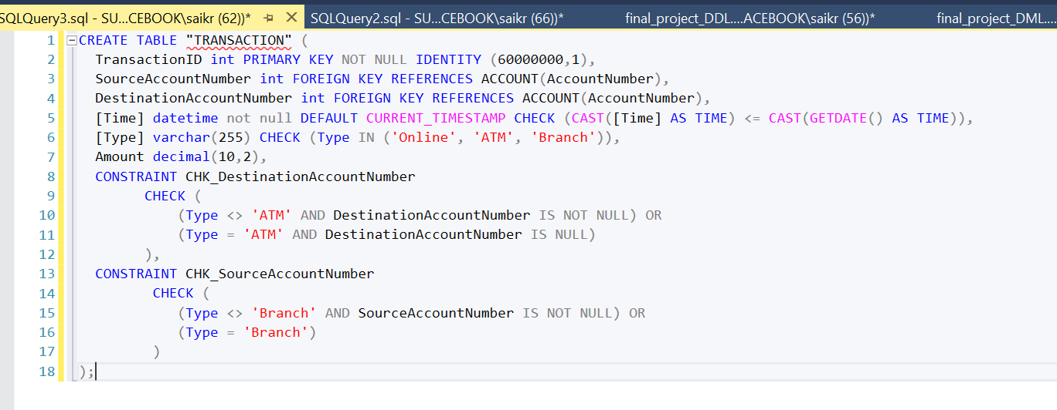
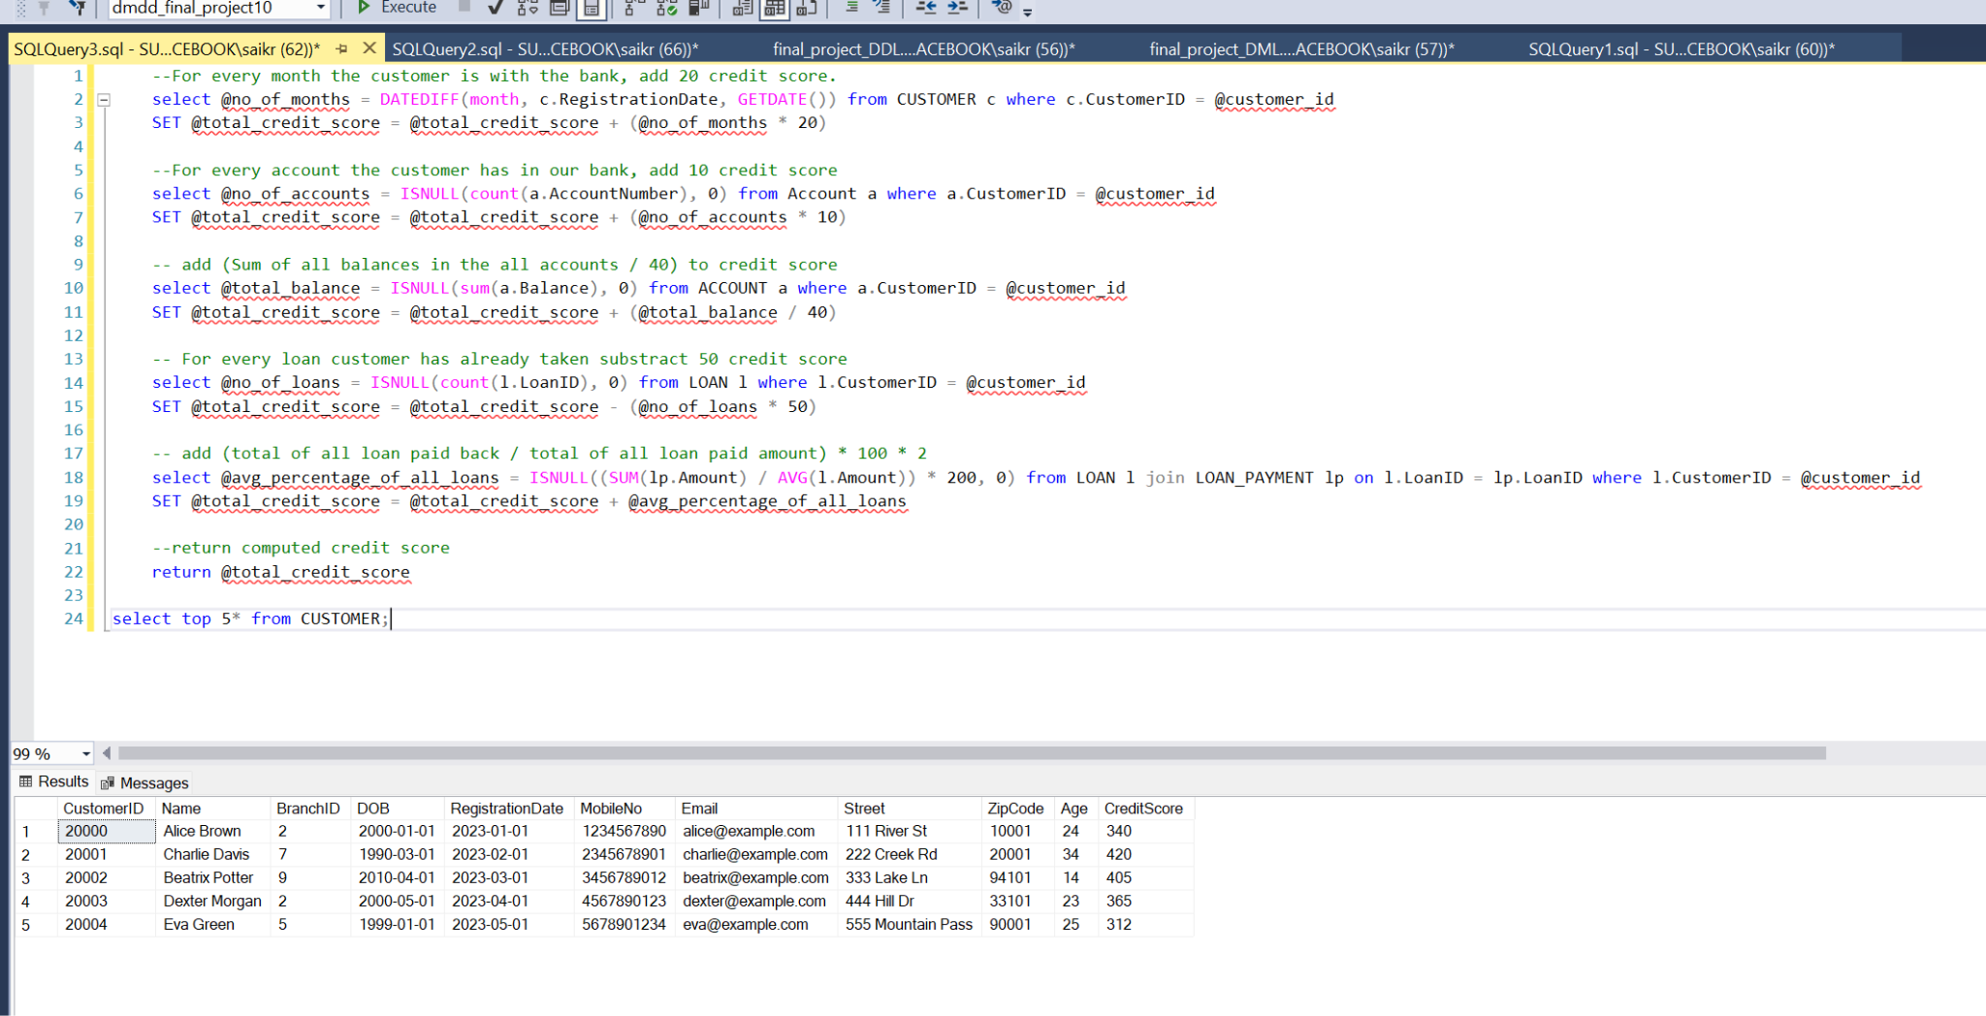
Applying Check Constraints Setting up User Defined Functions

Slide 9
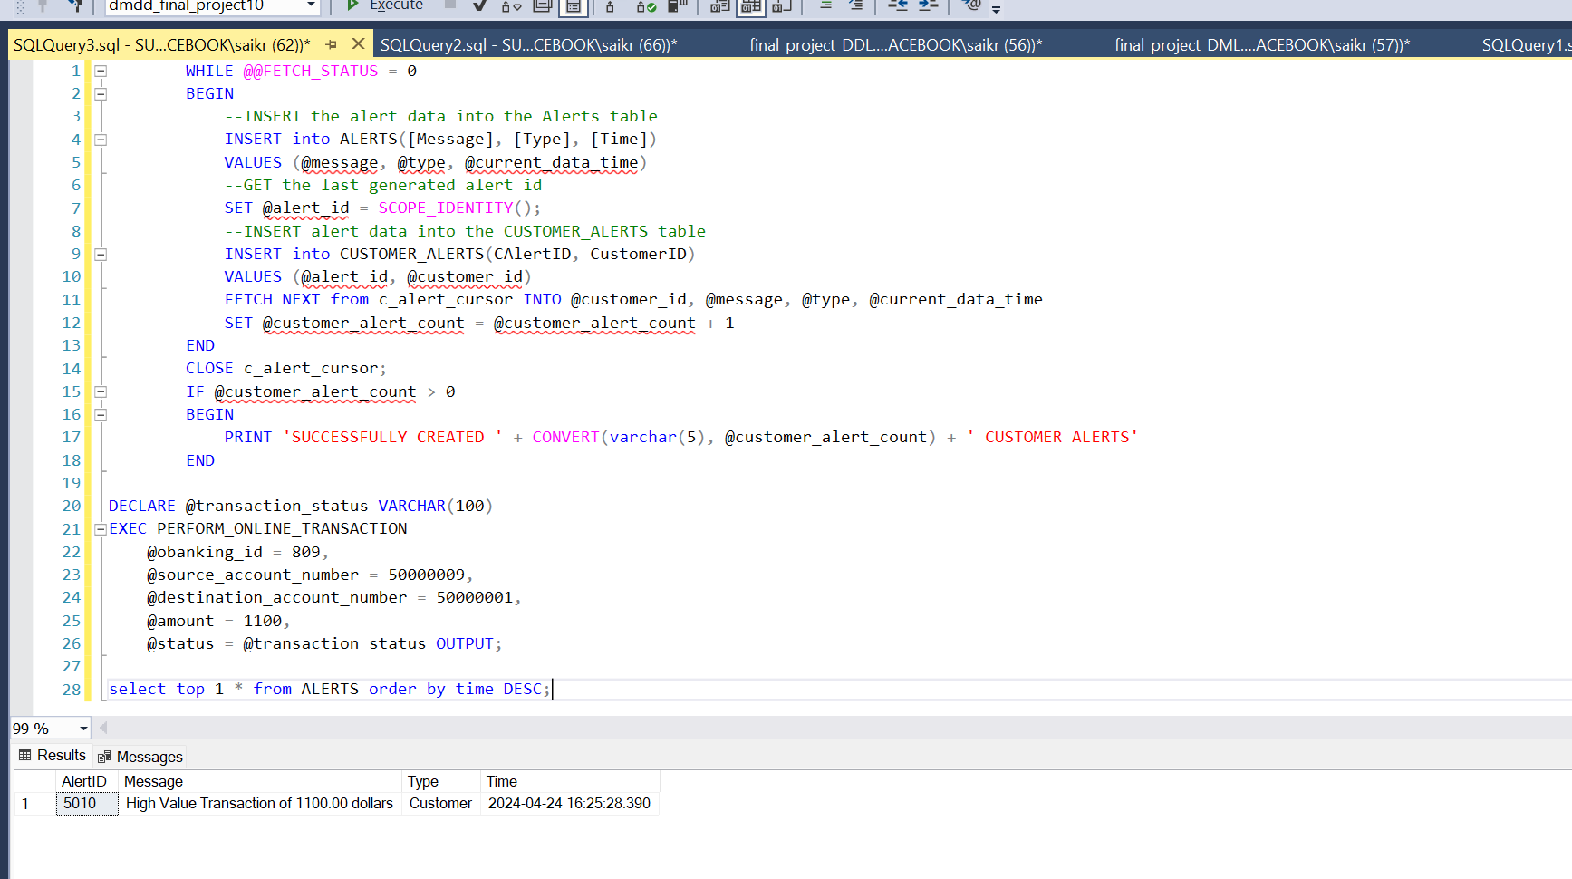
Defining triggers

Slide 10
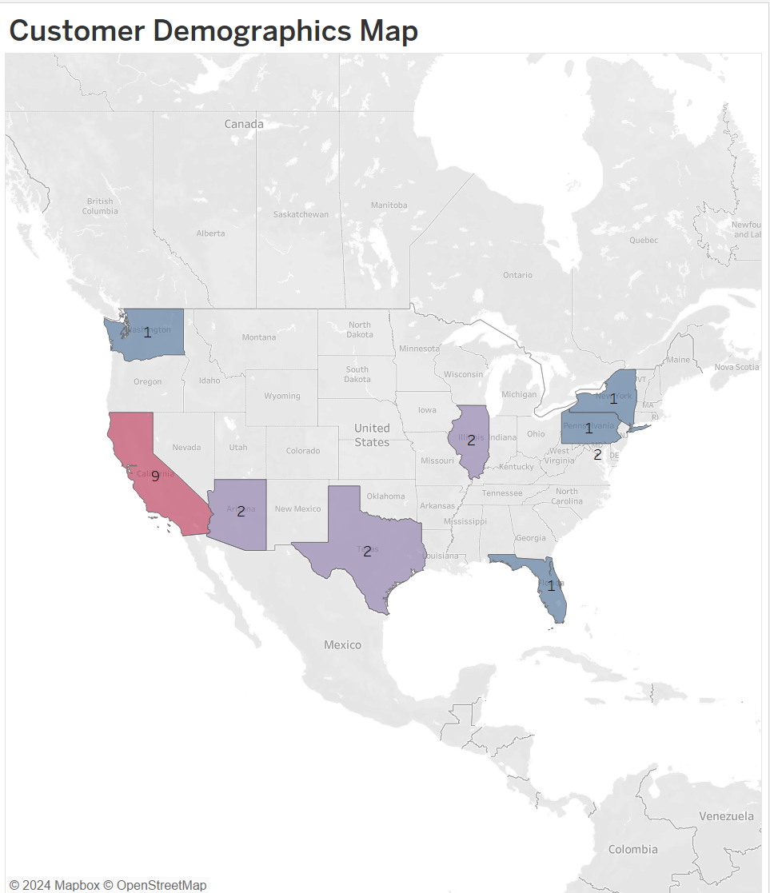
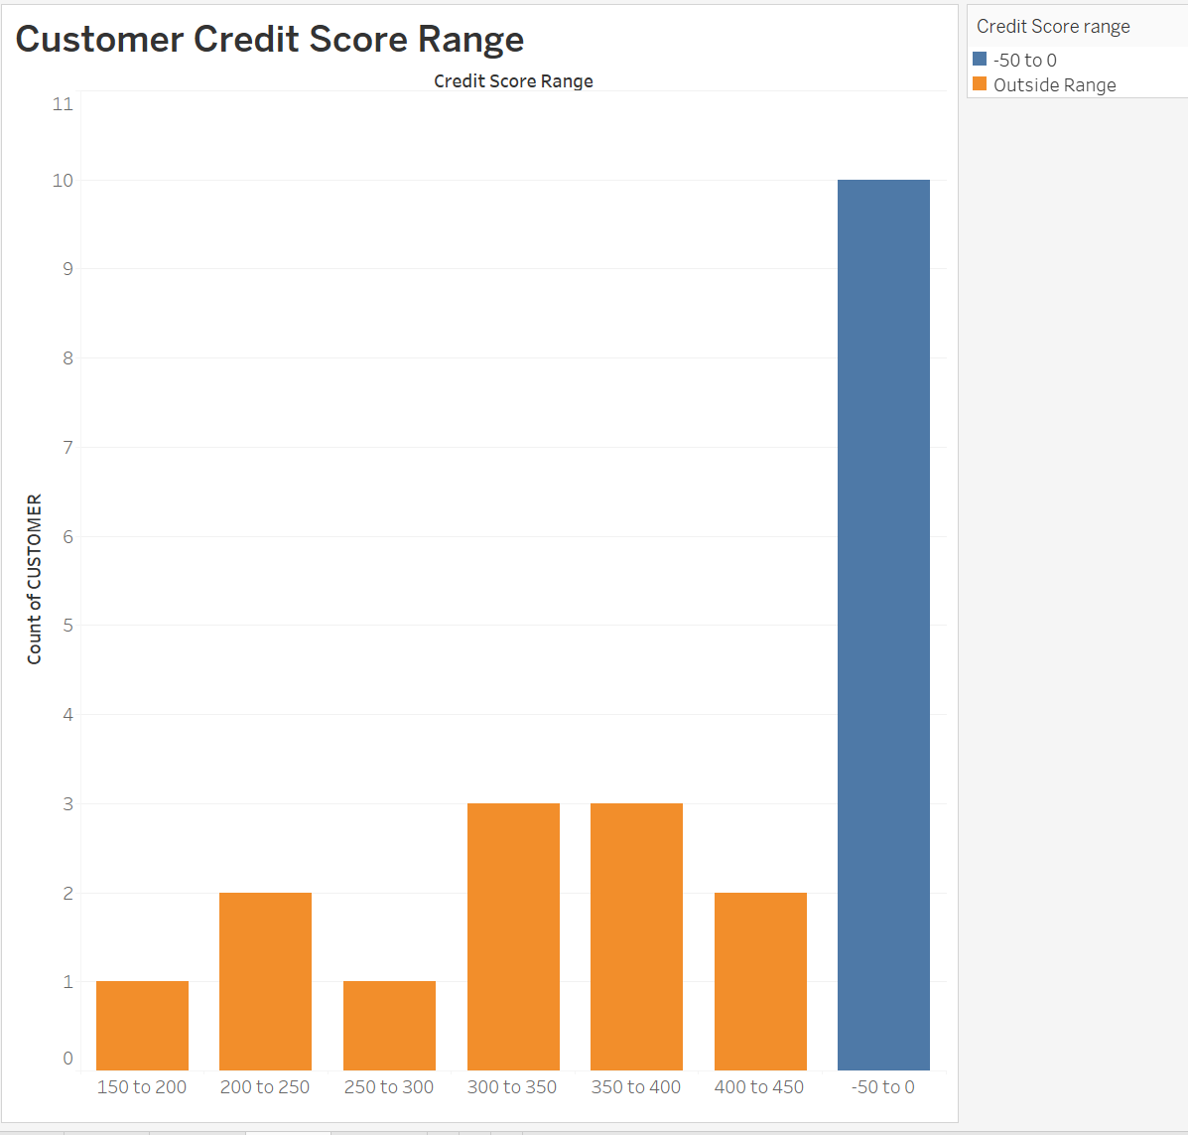

Slide 11
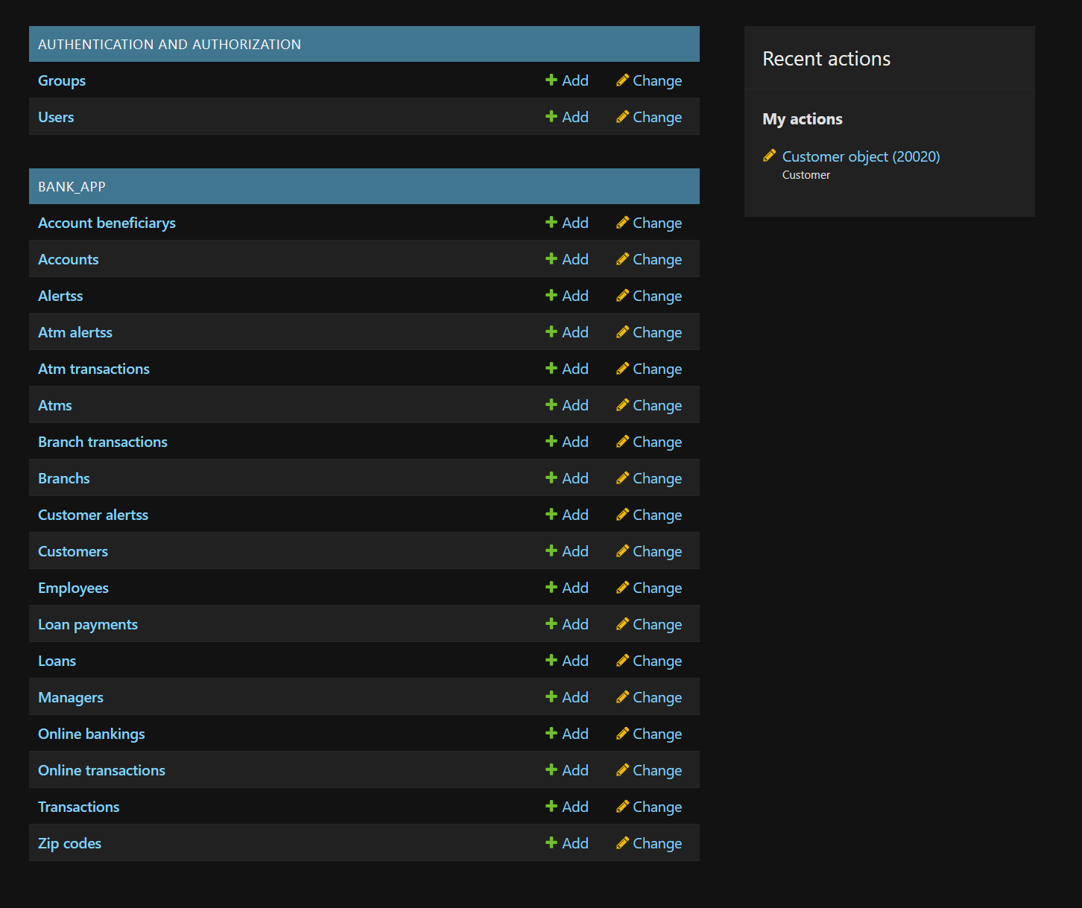
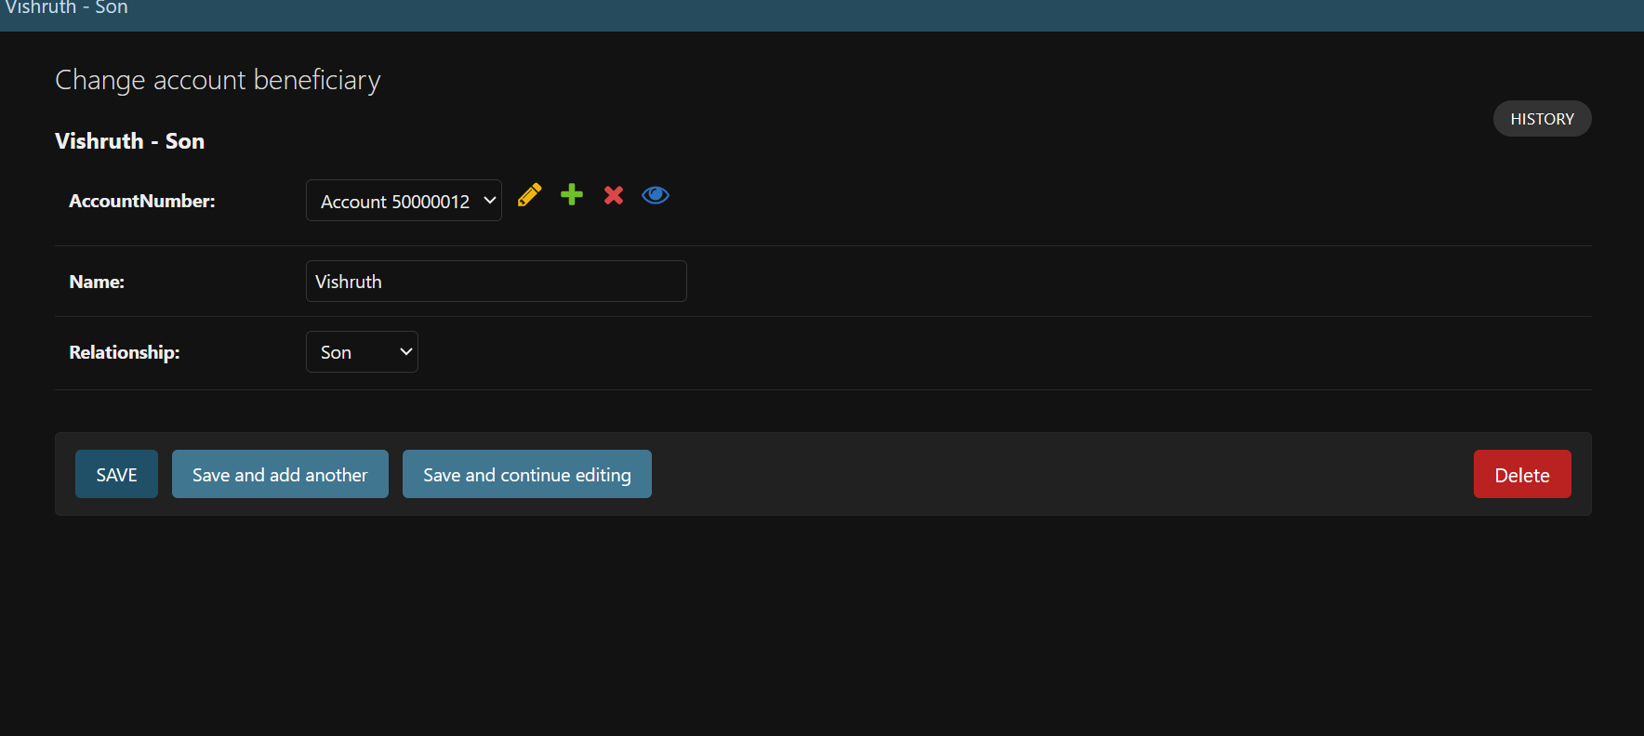
GUI
CRUD Operations

Slide 12
THANK YOU

